Slide 1

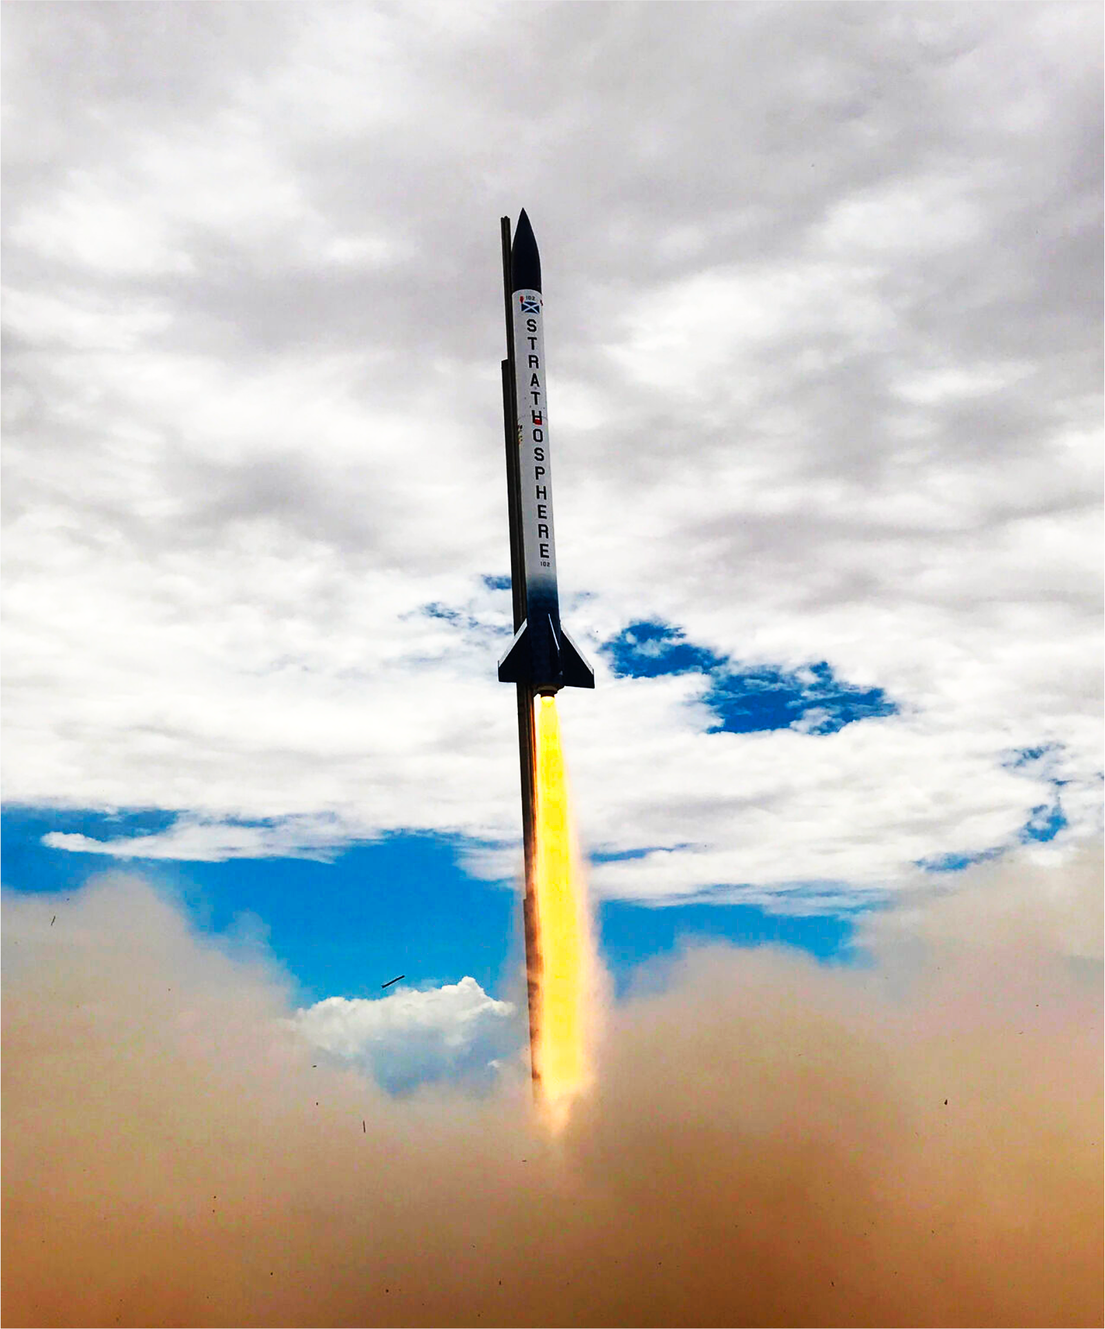
Avionics

Slide 2
Quick note
I get distracted very easily. If that happens, feel free to let me know.

Slide 3
Who’s doing what?
Flight computer:
Jonathan
Daniel
Zach
Telemetry visualization:
Misi
Nicholas
Power board:
Aurelija
Radio:
Thomas
If you change your mind, feel free to mention to me and we’ll sort that out.
If you expressed interest in more than one system I put you on the one with less people working on it.
GPS:
Konrad
Arun

Slide 4
Flight computer
Old flight control logic diagrams are available
As are old component choices
All previously chosen components were picked for a reason, but this does not make them the best. I encourage you to question the choices made in previous years.

Slide 5
Telemetry visualisation
Look at how to track rocket location and orientation from telemetry data.
I recommend using a mixture of vertical velocity and angular acceleration to track this, but that is simply a suggestion.
As you look into it you may find better ways.

Slide 6
Power board
I have an example I threw together, consider how you want to make it(possibly adding protection against short circuits or something?)
Just a combination of a battery holder and some contacts, possibly a fuse or some other current limiter.
Going to be pretty quick start before hopping onto something harder.

Slide 7
Radio
Gonna need an RF chip that works in the 450 MHz and/or the 900 MHz range. Ideally both.
Then will need to communicate with a board with your communication protocol of choice(I recommend SPI)
Then you’ll be playing with filters

Slide 8
GPS
Includes a lot of what the radio does for transmitting data
Also needs a receiver chip to catch signals from satelites
Then you have to decode it on some kind of processor(I recommend an stm32 of some kind but knock yourself out looking around)
Wanna see the maths behind this?(in basic principles at least)

Slide 9
Right, you’re all bored as hell now
What’ve you lot got to say to me?
I’m sure you have notes

